Slide 1
Parachain Economics
Logan Saether DeFi Discussions
03-05-2020

Slide 2

Logan Saether
Tech Education
Twitter: @logansaether Telegram: @Saetherlogan

Slide 3
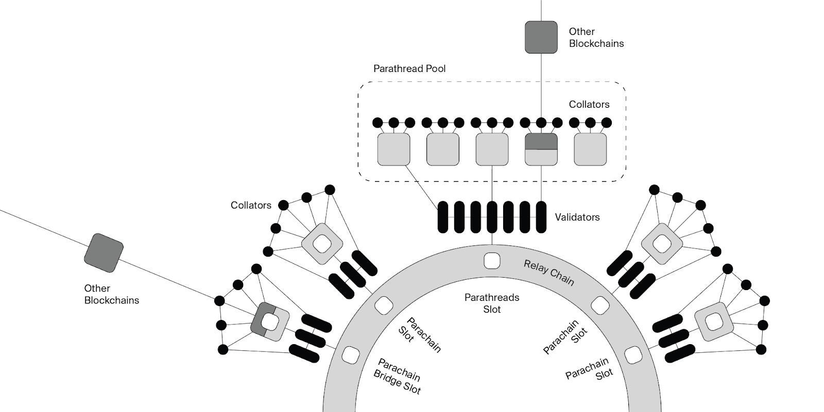
What are parachain economics?
In Polkadot there is an economic separation between the Relay Chain and parachains.
On the Relay Chain, DOT is the native currency.
DOTs are needed to acquire block inclusion in the Relay Chain.
Parachains are economic blank slates, with their own incentive structures that are independent from DOT.

Slide 4
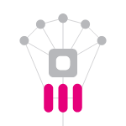

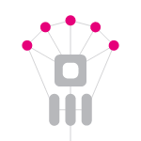



Roles and Definitions
The Relay Chain and parachains have a number of actors.
Validators are the staked entities that secure the Relay Chain and verify new parachain blocks.
Collators are the block produces of parachains, they package the transactions and hand off the PoV blocks to validators to verify.
Fishermen are nodes with small stake, watching one or more parachains, ensuring a collator is performing honestly.
Validator
Relay Chain
Collator
Parachain
Fisherman
Parathread

Slide 5

Parachain Slots
One way that guarantees inclusion of blocks at every Relay Chain block is to acquire a parachain slot.
Parachains acquire slots by participating in a parachain slot auction.
Slot auctions are held on a rolling basis every six months.
Slots are acquired for a lease period of 6 - 24 months.
Winning bidders will have their DOTs locked for the duration of the lease period.

Slide 6
Parachain Slot Auctions
six months
Bidder | Bid Amount | Lease Periods
Alice | 100 DOTs | (0, 3)
Bob | 70 DOTs 50 DOTs | (0,3) (0,1)
Charlie | 60 DOTs | (2,3)

Slide 7
Parachain Slot Auctions
six months
Bidder | Bid Amount | Lease Periods
Alice | 100 DOTs | (0, 3)
Bob | 50 DOTs | (0,1)
Charlie | 60 DOTs | (2,3)

Slide 8
Parachain Slot Auctions
six months
Bidder | Bid Amount | Lease Periods
Alice | 100 DOTs | (0, 3)

Slide 9
Parachain Slot Auctions
six months
Bidder | Bid Amount | Lease Periods
Bob | 200 DOTs | (2,5)

Slide 10
Parachain Slot Auctions
six months
Bidder | Bid Amount | Lease Periods
Bob | 200 DOTs | (2,5)

Slide 11

Candle Auctions
Parachain slot auctions will use a candle auction mechanism.
Candle auctions are a type of first-price auction that have a random duration (in other words an unknown close).
As it’s used in Polkadot the end time will be determined retroactively using the same VRF that is generated by validators and used in BABE.
The highest bid at the retroactively determined ending time will be the winner.

Slide 12
Candle Auctions
100 DOTs
200 DOTs
300 DOTs
Time ->

Slide 13
Candle Auctions
100 DOTs
200 DOTs
300 DOTs
Time ->
VRF determines the ending block

Slide 14

Crowdfunding Parachains
There is a built-in module for trustlessly crowdfunding parachain slots.
Contributors can lock their DOTs for a specific parachain and get their tokens back at the end of the term.
Parachain teams can incentivize this in different ways, such as by minting tokens on the parachain in accordance to the contributions.
Can be used to run Initial Parachain Offerings (IPOs) without trust.

Slide 15
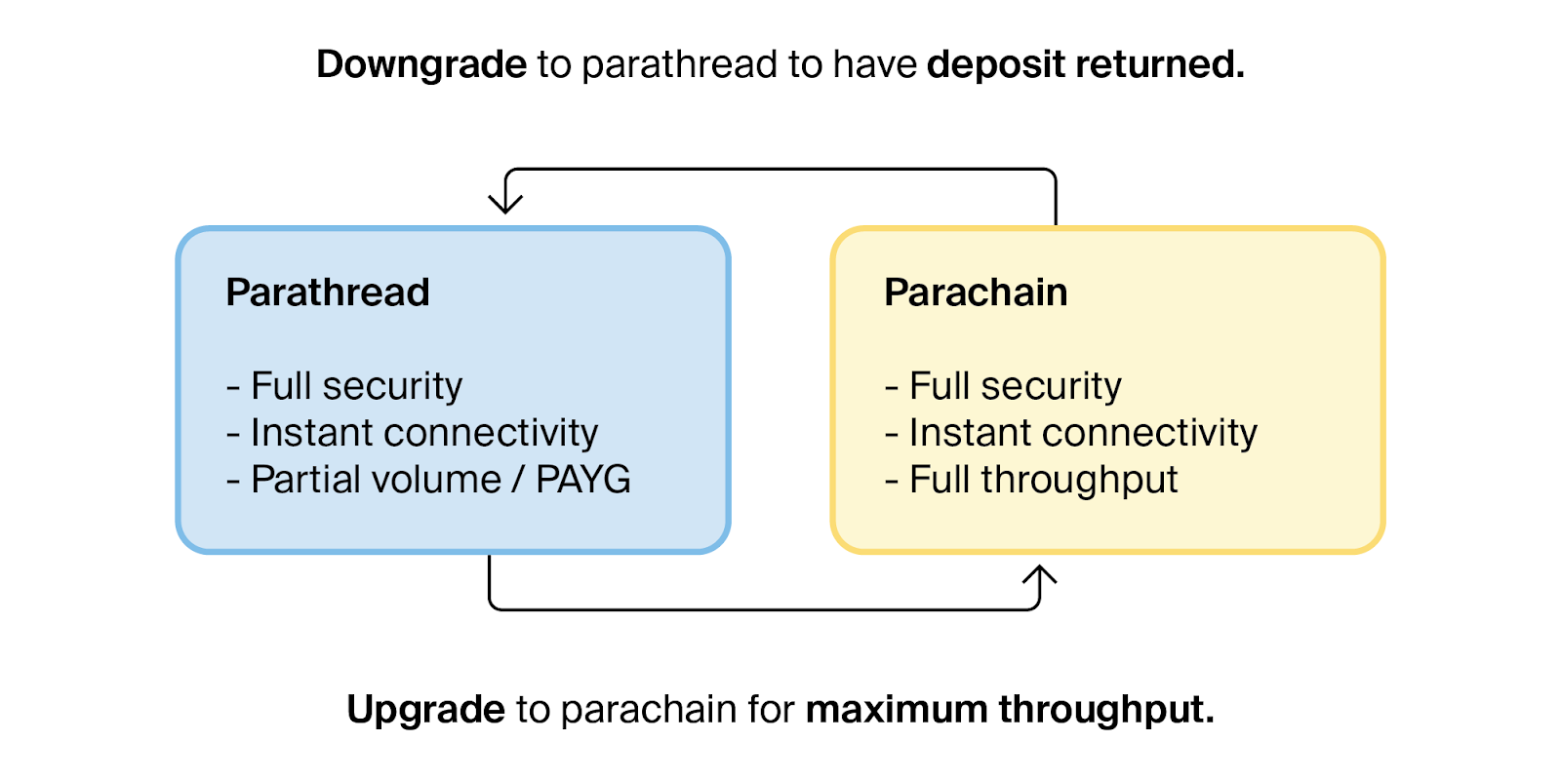
Parathread Economics
Technologically, parathreads have the same properties as parachains. However, the difference is economic.
While parachains have guaranteed inclusion in every Relay Chain block, parathreads must pay as they go.
To do this, parathreads will participate in a per-block auction against other parathreads in the pool.
Parathreads can switch into parachains and vice versa.

Slide 16
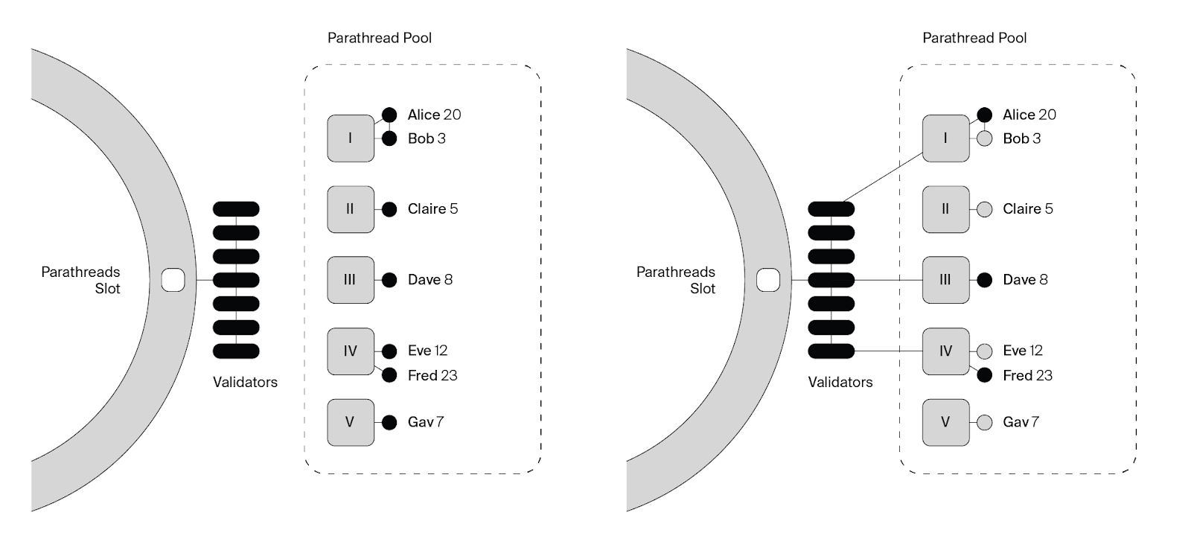
Parathread Auctions

Slide 17



Collator Incentivization on Parachains
Parachains are free to implement an incentivization scheme for collators that fits their economic model. There are various options they may choose (or come up with something new).
Transaction Fees
Transactor pay fees for transactions, these fees go to collators.
Familiar to most users of blockchains.
Treasury Subsidies
The project initially imbues an on-chain treasury with some funds.
The funds act as a “coinbase” for the collators.
External Incentives
The parachain team may bare the costs of running collators themselves and have some external benefit (such as onboarding more users).

Slide 18
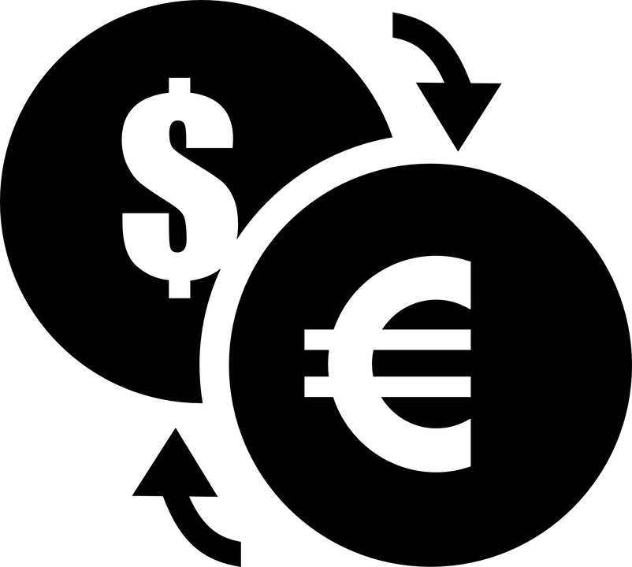
Incentivizing Parathread Collators
How does the incentivization of parathread collators differ?
Payment options are roughly the same as for parachains, with a few key differences.
Parathread collators must place bids to validators in DOTs (since this is the only currency the Relay Chain understands).
Parathread collators can accept any currency, whether this is a parathread native token, or a wrapped version of DOT.

Slide 19
Designing your own Parachain?

Slide 20
Parachain Economy Toolbox
Here are some of the standard tools for designing the economy from the ground-up.
Token Types
Utility
Asset-Backed
Spendable
Tradable
Fixed
Schedule-based
Inflationary
Burnable
Voting
Payment
Token Distribution
Private Investors
Crowdfunding Participants
Reserved for treasury
Reserved for IPOs
Founders & Employees
Reserved for Service Providers
Reserved for Ecosystem Funding
Reserved for Future Fundraising
Variables
Inflation Rate
Money Supply
Protocol Payouts
Block Rewards
Others
Deposits and Costs
Distribution

Slide 21
Get Involved !
Run a node or nominate a validator.
Use the web-based application to perform network tasks
Become a builder or network maintainer
Interact with Polkadot by being a builder or network maintainer
Node management
Nomination Guide
Builder’s Portal
Network Maintainers
Polkadot user interface
Builder’s Portal
Network Maintainers
See the governance proposals and validator dashboard
Visit the Polkadot’s block explorer.
Check the list and map of all running nodes.
Polkassembly
Polkastats
Polkascan
Subscan
Telemetry user interface.

Slide 22
Learn More
Wiki
White paper
Light paper
Website
FAQs
Substrate Dev Hub
Connect with the team
Additional Resources

